Slide 1
Inter-Domain Routing
Exercises ANS
Lecture 8 (Routing 5)
Slides credit: CS 168 @ UC Berkeley
Notes:
Slides template credit: Josh Hug, Lisa Yan

Slide 2
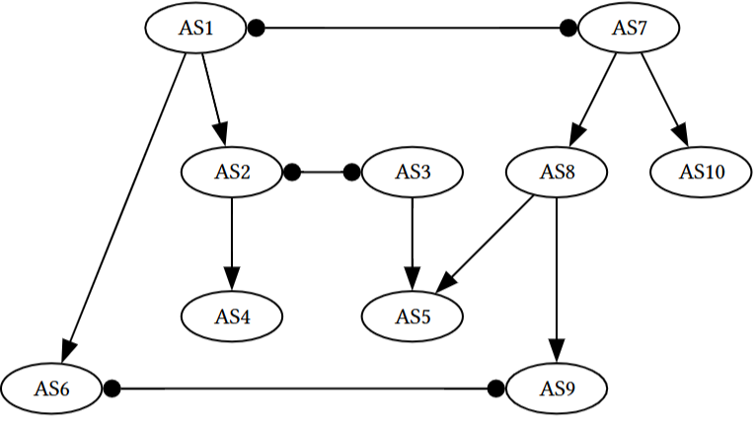
Q1. BGP
Consider the following configuration of autonomous systems and their relationships.
A square-triangle line indicates a provider-customer relationship, and a circle-circle line indicates a peer relationship. We have two tier 1 providers (AS1 and AS7). Assume we are using the following selection and export rules for all ASes:
Selection: Prefer to send data through customers > peers > providers in order to minimize costs.
Export: To customers, advertise all paths. To all other ASes, advertise only paths to customers (and paths to your own AS, of course).
1) A user in AS4 tries to send data to a friend in AS5. What path (if any) would the data take to get to the friend?
2) A user in AS6 tries to send data to a friend in AS5. What path (if any) would the data take to get to the friend?
3) A user in AS1 tries to send data to another user in AS9. What path (if any) would the data take?
Notes:
then after that after the midterm maybe we switch into layer four
14:15
and we start thinking about how do you actually build a reliable protocol so we showed you that little super simple Bob
14:21
sending 10 packets reliability protocol and some people pointed out there are some bugs in that that we didn't really
14:27
address and you're right a real solid state-of-the-art reli reliability protocol will take us four lectures to
14:34
build so we're going to spend two lectures building TCP to ensure reliability and then we'll spend two
14:40
more lectures talking about congestion control so that we ensure that the NH host don't overload the links and these
14:47
are associated with the third project which is all about transport and implementing
14:52
TCP and then after that two lectures at layer seven so we're basically moving up the stack and at layer seven there
14:59
there's two applications that we'll talk about one of them is DNS one of them is HTTP I won't talk about them any further
15:05
here because you'll get them a lot later but there are examples of things that we can build on top of the network to make
15:12
everything work and once we've traveled across all the layers in lecture 16 and 17 we'll go back and clean up all the
15:19
little missing pieces that we haven't really touched yet to form what we call the end to endend picture so by lecture
15:26
17 you will finally get the ultimate picture of what exactly happens when I send a packet from point A to point B
15:32
all of the missing pieces will get filled in we'll go through all these protocols that didn't really fit anywhere else but have to be covered and
15:40
we'll also spend a little bit of time at Layer Two and everything will be connected up so we'll spend a lot of time at layers three four and seven and
15:47
once we do that we'll Circle back and tie it all together in lectures 16 and 17 so that's the next part of the
15:57
semester

Slide 3
Q. BGP ANS
1) A user in AS4 tries to send data to a friend in AS5. What path (if any) would the data take to get to the friend?
ANS: AS4 → AS2 → AS3 → AS5
2) A user in AS6 tries to send data to a friend in AS5. What path (if any) would the data take to get to the friend?
ANS: AS6 → AS1 → AS7 → AS8 → AS5. Since AS2 won’t advertise its peer’s (AS3′s) path (about how to reach AS5) to its provider (AS1), so AS1 doesn’t know it can reach AS5 through AS2.
3) A user in AS1 tries to send data to another user in AS9. What path (if any) would the data take?
ANS: AS1 → AS7 → AS8 → AS9. Same reasoning as Part 2).
Provider
Peer
Customer
Notes:
then after that after the midterm maybe we switch into layer four
14:15
and we start thinking about how do you actually build a reliable protocol so we showed you that little super simple Bob
14:21
sending 10 packets reliability protocol and some people pointed out there are some bugs in that that we didn't really
14:27
address and you're right a real solid state-of-the-art reli reliability protocol will take us four lectures to
14:34
build so we're going to spend two lectures building TCP to ensure reliability and then we'll spend two
14:40
more lectures talking about congestion control so that we ensure that the NH host don't overload the links and these
14:47
are associated with the third project which is all about transport and implementing
14:52
TCP and then after that two lectures at layer seven so we're basically moving up the stack and at layer seven there
14:59
there's two applications that we'll talk about one of them is DNS one of them is HTTP I won't talk about them any further
15:05
here because you'll get them a lot later but there are examples of things that we can build on top of the network to make
15:12
everything work and once we've traveled across all the layers in lecture 16 and 17 we'll go back and clean up all the
15:19
little missing pieces that we haven't really touched yet to form what we call the end to endend picture so by lecture
15:26
17 you will finally get the ultimate picture of what exactly happens when I send a packet from point A to point B
15:32
all of the missing pieces will get filled in we'll go through all these protocols that didn't really fit anywhere else but have to be covered and
15:40
we'll also spend a little bit of time at Layer Two and everything will be connected up so we'll spend a lot of time at layers three four and seven and
15:47
once we do that we'll Circle back and tie it all together in lectures 16 and 17 so that's the next part of the
15:57
semester

Slide 4
Explanations (based on Gao-Rexford Rules)
1) AS4 → AS2 → AS3 → AS5.This path respects all Gao-Rexford rules:
AS2 has a peer neighbor (AS3) AND a customer neighbor (AS4)
AS3 has a customer neighbor (AS5 paying)
Path is valley-free (no going up after going down)
2) AS6 → AS1 → AS7 → AS8 → AS5. Since AS2 won’t advertise its peer’s (AS3′s) path (about how to reach AS5) to its provider (AS1), so AS1 doesn’t know it can reach AS5 through AS2.
Export policy: AS2 receives a route from peer AS3 (about reaching AS5)
Export rule: Routes from peers are only advertised/exported to customers (not to providers)
Therefore: AS1 (AS2's provider) does NOT learn about the AS3→AS5 path
So AS1 can only reach AS5 via AS7 (its peer) and then AS8→AS5. This forces the long path through Tier 1 providers
Peer
Customer

Slide 5
Explanations (based on Gao-Rexford Rules)
How about AS6 → AS9 → AS8 → AS5?
AS9 is a customer of AS8, and AS5 is also a customer of AS8. So:
AS5 → AS8 is customer to provider for route origination
AS8 → AS9 is provider to customer advertisement
AS9 learns the AS5 route from its provider AS8
Now the key export rule applies: Routes learned from a provider or peer are exported only to customers
AS9 learned the route to AS5 from provider AS8, therefore AS9 cannot advertise that route to peer AS6. So AS6 does not learn the AS6 → AS9 → AS8 → AS5 path.
The valley-free view says the same thing:
AS6 → AS9 = peer. AS9 → AS8 = up. AS8 → AS5 = down
That is peer, then up, then down, which is not valley-free. In Gao–Rexford, the allowed pattern is:
zero or more up edges,
then at most one peer edge,
then zero or more down edges.
So this path violates the rule.
AS6 → AS9 → AS8 → AS5 is invalid because AS9 learns the route from a provider and cannot export it to its peer AS6.
Peer
Customer

Slide 6
Explanations (based on Gao-Rexford Rules)
3) AS1 → AS7 → AS8 → AS9.This path respects all Gao-Rexford rules:
AS1 is a Tier 1 AS (no providers)
AS7 is also a Tier 1 AS (peering with AS1)
To reach AS9, AS1 needs a path advertised by AS7
AS7 receives routes from customers (AS8) and peers (AS1)
Export rule: AS7 advertises customer routes (AS8's path) to all ASes
So AS1 can use: AS1 → AS7 → AS8 → AS9
The principle is the same (export policies hide certain paths), but the mechanics are slightly different. Comparison:
Part 2: AS1 tries to reach AS5 through AS2 (but AS2 hides the peer path)
Part 3: AS1 tries to reach AS9 through AS7 (which advertises its customer's route)
Peer
Customer

